Slide 1
Introduction to Fuzzy Logic
Aplikasi Teknologi Cerdas

Slide 2
Outline
Classical Logic
Fuzzy Logic
Classical Set vs Fuzzy Set
Reference:
Stuart J. Russell and Peter Norvig : Artificial Intelligence - A Modern Approach
Sivanandam, Deepa, Sumathi, S : Introduction to fuzzy logic using MATLAB-Springer

Slide 3
Introduction to Fuzzy Logic
Classical Logic:
Fuzzy Logic:
Yes | No
True | False
Hot | Cold
Hot Medium Hot Normal Medium Cold Cold

Slide 4
Introduction to Fuzzy Logic
Our perception of the real world is pervaded by concepts which do not have sharply defined boundaries – for example, many, tall, much larger than, young, etc. are true only to some degree and they are false to some degree as well.
These concepts (facts) can be called fuzzy or gray (vague) concepts – a human brain works with them, while computers may not do it (they reason with strings of 0s and 1s).
Usually, the classification is subjective. We think a temperature is considered medium hot, but maybe a baby feels that it is very hot.
Hot Medium Hot Normal Medium Cold Cold

Slide 5
Introduction to Fuzzy Logic
The Fuzzy Logic tool was introduced in 1965 by Lotfi Zadeh
It provides a technique to deal with imprecision and information granularity.
The fuzzy theory provides a mechanism for representing linguistic constructs (“many,” “low,” “medium,” “often,” “few”)
Fuzzy logic provides an inference structure that enables appropriate human reasoning capabilities

Slide 6
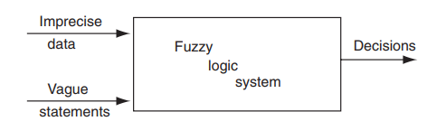
Introduction to Fuzzy Logic
Fuzzy logic system accepts imprecise data and vague statements

Slide 7
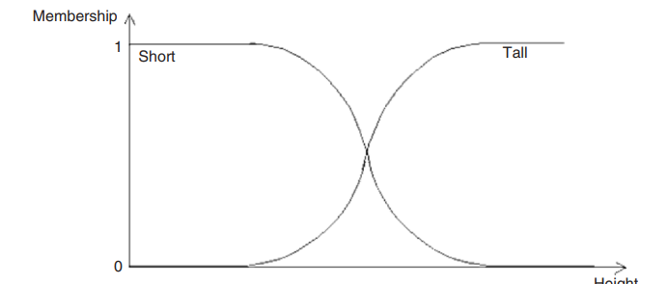
Introduction to Fuzzy Logic
Example:
The classification is subjective – it depends on what height is measured relative to. At the extremes, the distinction is clear, but there is a large amount of overlap in the middle

Slide 8
Classical/ Crisp Set vs Fuzzy Set

Slide 9
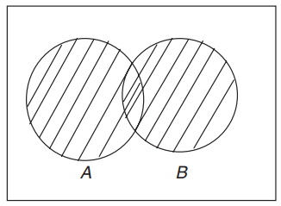
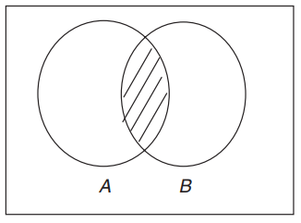


Classical Set Operation
Consider two sets A and B defined on the universe S.
Its characteristic function assigns a value of either 1 or 0 to each individual in the universal set
S
S
$$A∪B=\{x|x∈A or x∈B\}$$
$$A∩B=\{x|x∈A and x∈B\}$$
Union
Intersection

Slide 10
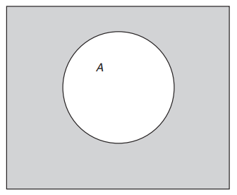
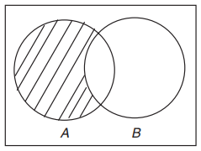


Classical Set Operation
S
S
$$\overline{A}=\{x|x∉A, x∈S\}$$
$$A|B=\{x|x∈A and x∉B\}$$
Complement
Difference

Slide 11

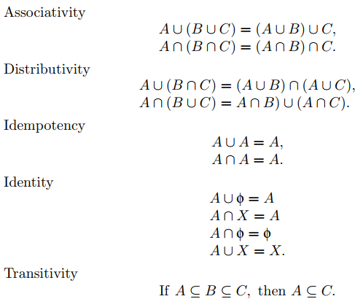


Classical Set Properties

Slide 12
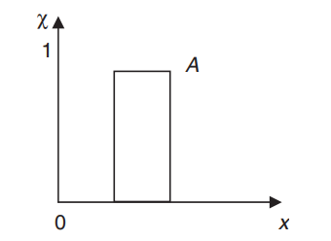

Membership Mapping of Classical Set
The value is only 1 or 0

Slide 13
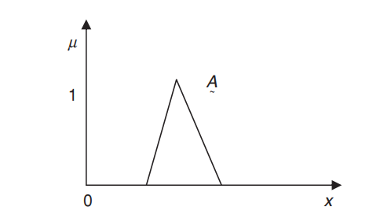

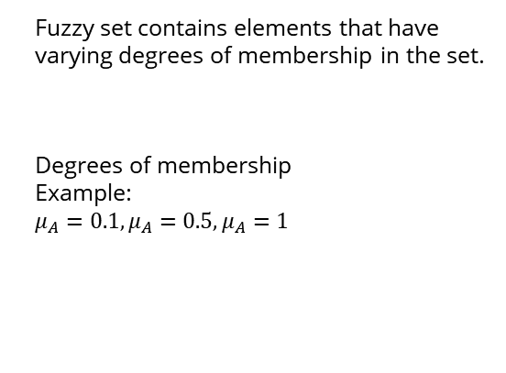
Fuzzy Set
Fuzzy set contains elements that have varying degrees of membership in the set.
Degrees of membership
Example:
$μ_{A}=0.1,μ_{A}=0.5,μ_{A}=1$
Mapping:
Membership Function of Fuzzy Set A

Slide 14
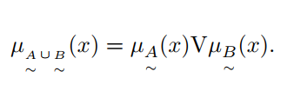

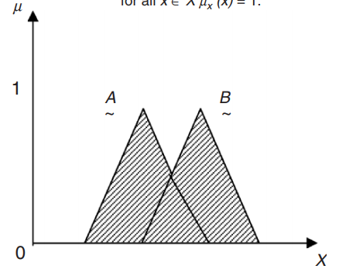
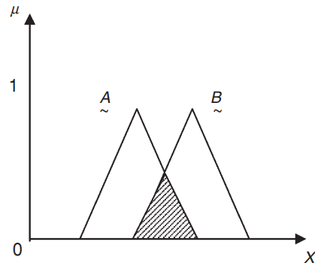
Fuzzy Set Operations
Consider Fuzzy Sets A, B, C on universe X
Union:
Intersection:

Slide 15

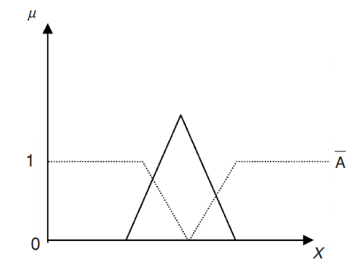
Fuzzy Set Operations
Complement:

Slide 16
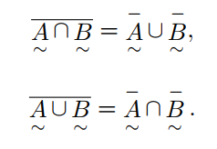
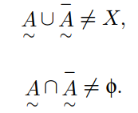
Fuzzy Set Operations
De Morgan’s Law:
Excluded Middle Law:

Slide 17
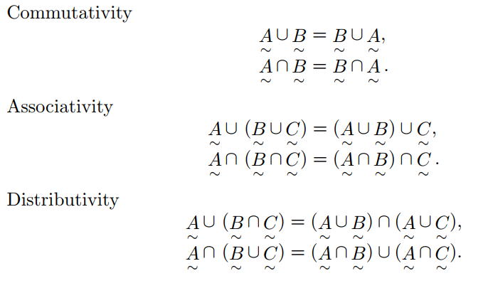
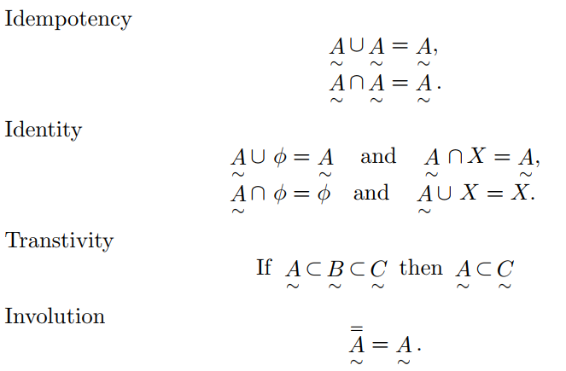
Properties of Fuzzy Set

Slide 18
Fuzzy Set
Fuzzy set contains elements that have varying degrees of membership in the set.
Degrees of membership
Example:
$μ_{A}=0.1,μ_{A}=0.5,μ_{A}=1$
Mapping:
Membership Function of Fuzzy Set A

Slide 19
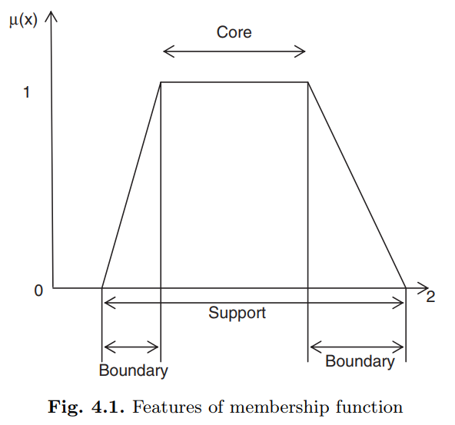
Membership Function (MF)
Fuzziness in a fuzzy set is characterized by its membership functions
It contains degrees of membership
Membership value

Slide 20
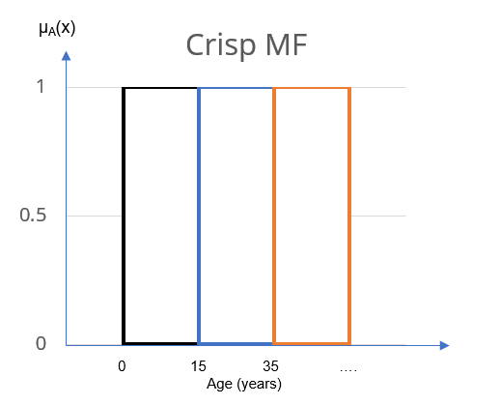
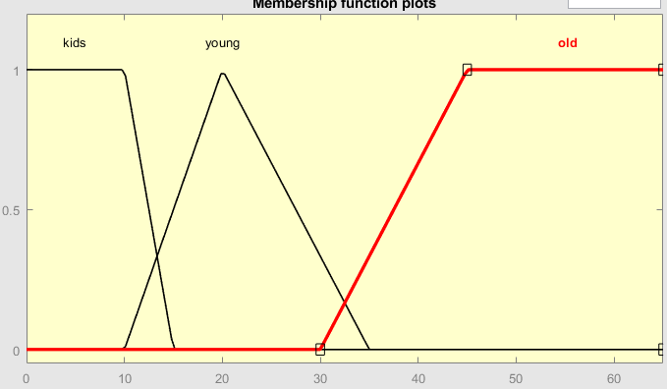
Crisp vs Fuzzy MF
Fuzzy MF
μ_{A}(x)
Age (years)

Slide 21
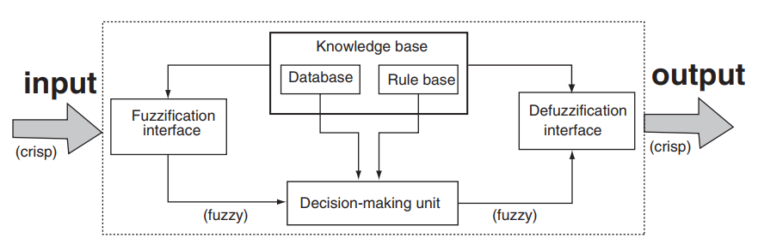
Fuzzy Inference System (FIS)
Fuzzy Inference Diagram

Slide 22
Fuzzy Inference System (FIS)
Langkah-Langkah Decision Making dengan FIS
Membuat fuzzy set untuk input dan output
Membuat fuzzy rule
Menerapkan fuzzy rule pada fuzzy set input
Mengkomposisi output

